Slide 1

Department of CSIT
COURSE NAME
FOUNDATIONS OF CLOUD-NATIVE COMPUTING & DEVOPS
COURSE CODE –24CS2260F
Topic:
cost-awareness for small clusters
Session - 6

Slide 2
Why Cost Awareness is Important
Kubernetes abstracts infrastructure resources, which can hide actual costs from users.
Without cost awareness, clusters may run idle workloads, oversized containers, and unused resources.
Cost awareness helps organizations:
Reduce unnecessary spending
Improve resource efficiency
Maintain sustainable operations

Slide 3
Cost Drivers in Kubernetes
The major cost drivers in Kubernetes clusters include:
CPU and memory usage
Number and size of nodes
Storage volumes and persistence
Network traffic and load balancers
Understanding these drivers helps control expenses.

Slide 4
Resource Requests and Limits
Kubernetes uses resource requests and limits to manage CPU and memory usage. Incorrect values can lead to over-provisioning or instability.
Requests define guaranteed resources
Limits define maximum usage
Setting realistic values improves utilization and reduces cost.
Operators can monitor actual resource usage using built-in commands.
kubectl top pod
This helps identify pods that are over-allocated or underutilized.

Slide 5
Over-Provisioning vs Right-Sizing
Over-provisioning occurs when pods request more resources than needed, leading to wasted capacity.
Right-sizing means adjusting requests and limits based on real usage.
Regular review of metrics helps right-size workloads and reduce node costs.

Slide 6
Node Utilization Awareness & Scaling for Cost Efficiency
Nodes are often the largest cost contributors. Low node utilization indicates wasted spending.
Command:
kubectl top node
This command helps identify underutilized nodes that can be scaled down or removed.
Kubernetes supports scaling mechanisms that help control costs:
Horizontal Pod Autoscaling (HPA) scales pods based on demand
Manual scaling reduces pods during low traffic periods
Scaling ensures resources match workload demand.

Slide 7
Avoiding Idle and Unused Resources
Idle resources increase costs without delivering value.
Common examples:
Unused namespaces
Stopped but running pods
Orphaned services and volumes
Regular cleanup is essential for cost control.
Example:
kubectl get all --all-namespaces

Slide 8
Storage Cost Awareness
Persistent volumes and storage classes can incur ongoing costs even when not actively used.
Cost-aware practices include:
Deleting unused PVCs
Choosing appropriate storage classes
Avoiding oversized volumes

Slide 9
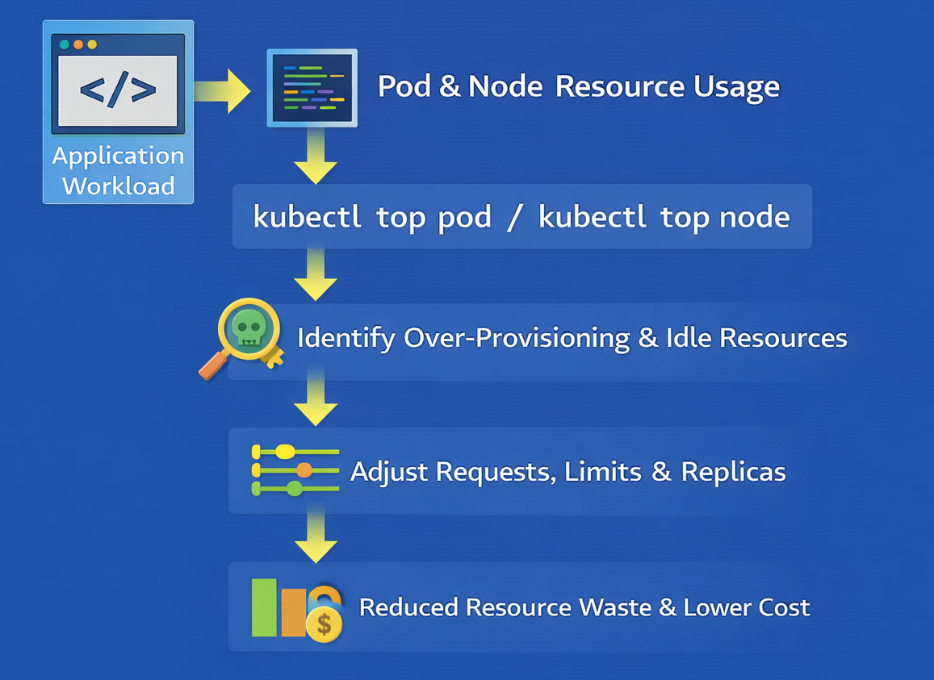
Lightweight Cost Monitoring Workflow
This workflow shows how basic monitoring and adjustment reduce costs without advanced tooling.

Slide 10
Cost-Saving Best Practices for Small Clusters
Set realistic resource requests and limits
Monitor node and pod usage regularly
Scale workloads during off-peak hours
Clean up unused resources
Prefer lightweight observability tools
These practices provide immediate cost benefits.

Slide 11
Trade-offs and Limitations
Basic cost awareness does not provide:
Precise per-team cost allocation
Long-term cost forecasting
However, it is sufficient for small clusters and early production environments.

Slide 12
Summary
Cost awareness in Kubernetes focuses on understanding resource usage and minimizing waste.
By monitoring pods and nodes, right-sizing workloads, cleaning unused resources, and scaling wisely, small clusters can achieve efficient and cost-effective operations without complex tooling.

Slide 13

THANK YOU
Team –Foundations Of Cloud-native Computing & Devops

